Slide 1
TRANSITIONS Protecting Assets/College Savings Resident Conference September 20th, 2018
Jeff Janowicz, MD
Emergency Medicine

Slide 2
Thanks
Speakers
MCES
Erik Olsen
Evaluations

Slide 3
Keep in Mind
You have become a medical professional, but not a financial professional
You don’t know much about tax brackets, payroll taxes, SS, insurance, schedule C, pensions, investing, malpractice, financial planners, lawyers…etc.
Need to learn to Make it, Take it, Protect it, and Grow it

Slide 4
Keep in Mind
Some of the most important decisions that affect your career and financial health aren’t where you work
spouse/children/divorce/parents
house(s)/mortgage/where you live
retirement planning/investing/budget
health/hobbies/friends/faith

Slide 5
Keep in Mind
In August 2019, you will be given a check for about $25,000
Feds 25%
MI 4.3%
FICA/Medicare 7.65% (15.3% if IC)
Detroit 1.1%
Total 38.05% (45.7 if IC)

Slide 6
2014 AGI Percentiles
Percentile | All | Single | MFJ
91 | 160,864 | 67,187 | 198,101
95 | 200,026 | 87,149 | 298,737
96 | 235,687 | 95,378 | 336,706
97 | 290,860 | 109,210 | 391,010
98 | 360,435 | 143,705 | 477,128
99 | 506,553 | 193,307 | 761,938
Source: Urban-Brookings Tax Policy Center

Slide 7
Income vs. Net Worth
New attendings have high income, but a dismally low net worth
1 Million net worth by age 40 is a great goal
Grow wealth and worth by regular savings and compound interest and paying off debt
Personality type matters

Slide 8
Protecting Assets
Jeff Janowicz, MD
Emergency Medicine

Slide 9
Assets
A substantial investment is necessary to get everything set up to protect your assets
- time - effort - difficult decisions - money

Slide 10
Disclaimer
No formal education
Experience only
No financial gain
Opinions only
Personality

Slide 11
Insurance
Whole Life - insurance for your whole life, with portion of your payment invested and therefore has “cash value” you can draw from
Umbrella Insurance - liability insurance in excess of limits covered by other policies (home, auto, etc,)

Slide 12
Long Term Care Insurance
Assistance received if unable to perform 2 ADLs
In-home care, assisted living, nursing home all covered
21% of households in US care for person older than 50 years
30yo, 90 Day Elimination, $6,000/month for 36 months costs $30/month ($360/year)

Slide 13
Term Life Insurance
Why Do You Need It?
Support your spouse
Mortgage coverage
Day care coverage
College expenses for children
Private student loans
Debt payoff
Funeral expenses

Slide 14
Term Life Insurance
How Much Do You Need?
No kids:
Recommended 5X gross income ($1.25 million)
With kids:
Recommended 10X gross income ($2.5 million)

Slide 15
Different Approach
Need a Death Plan:
What is your goal?
Children change everything
One of the great acts of love

Slide 16
My Death Plan
Status: married, 1-yr old child,
Goal: Allow my wife to take care of children without working
Life Insurance - $2,000,000 (20 year term policy)
Expenses:
$450,000 pay off house
$90,000 college fund
$500,000 long term investment (retirement)
$500k at 31 yo at 6% = 2.7 million at 60yo
$960,000 to live off of for 17 years ($4700/mo)

Slide 17
Life Insurance
How Much Does It Cost?
31 y.o. healthy male (Preferred)
$2 Million Twenty Year Term -- $1060 (Klever pays $600,)
Remember that insurance rates usually jump every 5 years

Slide 18
Term Life Insurance
Accelerated Death Benefit Rider
Will pay you up to 75% of your benefit if diagnosed with terminal illness and less than 12 months to live
This should not add any cost to policy

Slide 19
Term Life Insurance
Things To Keep In Mind:
Shop around!
Check to see that employer provided policy is paid for by you then reimbursed
Buy life insurance for your spouse if you have children
Be honest on your PMH/FH forms/have a PCP

Slide 20
Disability Insurance
Why Do You Need It?
Minor injury may disable you as an emergency physician
If you become disabled, you may need a higher income to cover the expenses of your new lifestyle
Your student loan bills keep coming if you are disabled

Slide 21
Options

Slide 22
Options

Slide 23
Disability Insurance
How it works:
Application
Income verification (W-2, paystubs, contract)
Medical/Personal history
Medical labs/specimen samples
Pregnancy may increase your risk
Prepare for you lab tests appropriately

Slide 24
Disability Insurance
Things To Keep In Mind:
Women should try to purchase a “Unisex” policy
Men should try to purchase a “Male-Only” policy
Coverage is non-cancellable, guaranteed renewable to age 65 (or 70)
EM can purchase up to $25,000 per month

Slide 25
Disability Insurance
Understand the Risk
90% illness
cancer
joint/spine disorders
MS
10% injury
Company that MCES uses has nearly 20% claim rate for emergency physicians over their lifetime

Slide 26
Disability Insurance
Base Policy
- True Own-Occupation
- 30/90 Day Elimination Period
- To age 65
- Graded/Level Premium
Add Riders
- Purchase additional benefit options

Slide 27
Disability Insurance
Own Occupation Rider:
Must purchase this rider
Will pay you if you cannot perform “Material and substantial duties” of your occupation
If totally disabled, policy will pay if you can not be an EM physician even if gainfully employed in another occupation or capacity.

Slide 28
Disability Insurance
Partial Disability Benefits Rider:
Will pay you if you suffer partial (residual) disability and are still able to work (pays 50% of your benefit)
Will make your income “whole”
MCES insurance rep has paid more partial disability benefits than full disability benefits over his career

Slide 29
Disability Insurance
Cost Of Living Adjustment (COLA):
Adjustment increase of payment to you every year based on CPI-U capped at percentage specified in contract (usually 3%)
Consider this rider in the beginning, drop it toward the end of your career

Slide 30
Disability Insurance
Future Increase Option Rider:
Allows you to increase your monthly insurance amount without having to take another medical exam
May be used for a resident who wants to buy some disability insurance now, but wants to increase that amount once they become an attending

Slide 31
Disability Insurance
Student Loan Protection Rider:
Pay up to $2,500 per month for up to ten years (total benefit of $292,000)
Might consider this if you have a large loan amount in the beginning of your career, but drop it as you progress with your loan repayment

Slide 32
Disability Insurance
Retirement Protection Plus (RPP):
Replacing retirement contributions made previously by employer if you become disabled
Various monthly contributions may be selected
Common rider pays $3,000/month into retirement account after 180-day elimination
Essentially replaced by increase in monthly amount attainable (25K)

Slide 33
Disability Insurance
Things To Remember:
If possible, purchase policy yourself, then get reimbursed from employer if possible
Reputable company is more important for disability insurance than life insurance
You can over-insure yourself
Leveragerx.com (great for disability insurance learning)

Slide 34
Disability Insurance
Things To Remember:
Not all states allow you to have own occupation coverage for life (MI does)
You may want to purchase insurance in Michigan before leaving residency (disability insurance follows you, resident discounts, mental health/substance abuse discount)

Slide 35
Disability Insurance
Policy Type/Rider Percent of Policies Sold
Own Occupation 93%
Residual Disability 96%
90 Day Elimination 88%
COLA 70%
Student Loan Payment 4.6%
Purchase Date
Resident 1st+2nd yr 28%
Resident 3rd yr 29%
1st Yr Attending 15%

Slide 36
How Much Does It Cost?
$5,000/month, 90 Day Term, 30yo, Own Occupation
Male Female
Base $1423 $2377
Residual Disability Rider $240 $376
COLA (3%) $283 $343
Student Loan Protection $191 $378
Total $2537 $4135
10% discount mental health/substance abuse -$254 -$414
10% discount resident -$254 -$414
Total with Discounts $2030 $3308

Slide 37
How Much Does It Cost?
Female, $5000/month, 30yo, 90 day elimination:
Level Premium: (highly recommended)
$355/month, $4135/yr
Graded Premium:
$201/month, $2346/yr
You will pay $62,026 more over the policy lifetime

Slide 38
Wills
• Legal document that allows you to name beneficiaries of your property upon your death and to name a guardian for your children
• Still has to go through probate court which is time consuming and expensive and public

Slide 39
Testamentary Trust
Also called a “will trust”
Attached to a will, and is created at settlors death
Allows way to distribute assets to beneficiaries
Less expensive to start
Still has to go through probate
Requires yearly probate review
Gives assets to beneficiaries (children)

Slide 40
Irrevocable Trusts
• A relationship whereby property is held by one party for the benefit of another
• Designates and obligates a “trustee” to administer the trust in accordance with the terms of the trust
• You can put anything you want in a trust

Slide 41
Irrevocable Trust Major Purposes
• Privacy (avoids probate)
• Estate Planning/Minors
- Distributions to Minor Children at 21, 25, 30
- Spendthrift Protection
• Allows children to be taken care of until adulthood per your instructions
• Designates multiple lines of succession who are “Able and willing” to take care of children

Slide 42
Tax Exemption?
Year | Exemption | Tax Rate
2005 | $1.5 million | 47%
2008 | $2.0 million | 45%
2009 | $3.5 million | 45%
2010 | unlimited | 0
FUTURE | ? | ?
Uncertainty – how to avoid estate tax?
AB Trust for married couples

Slide 43
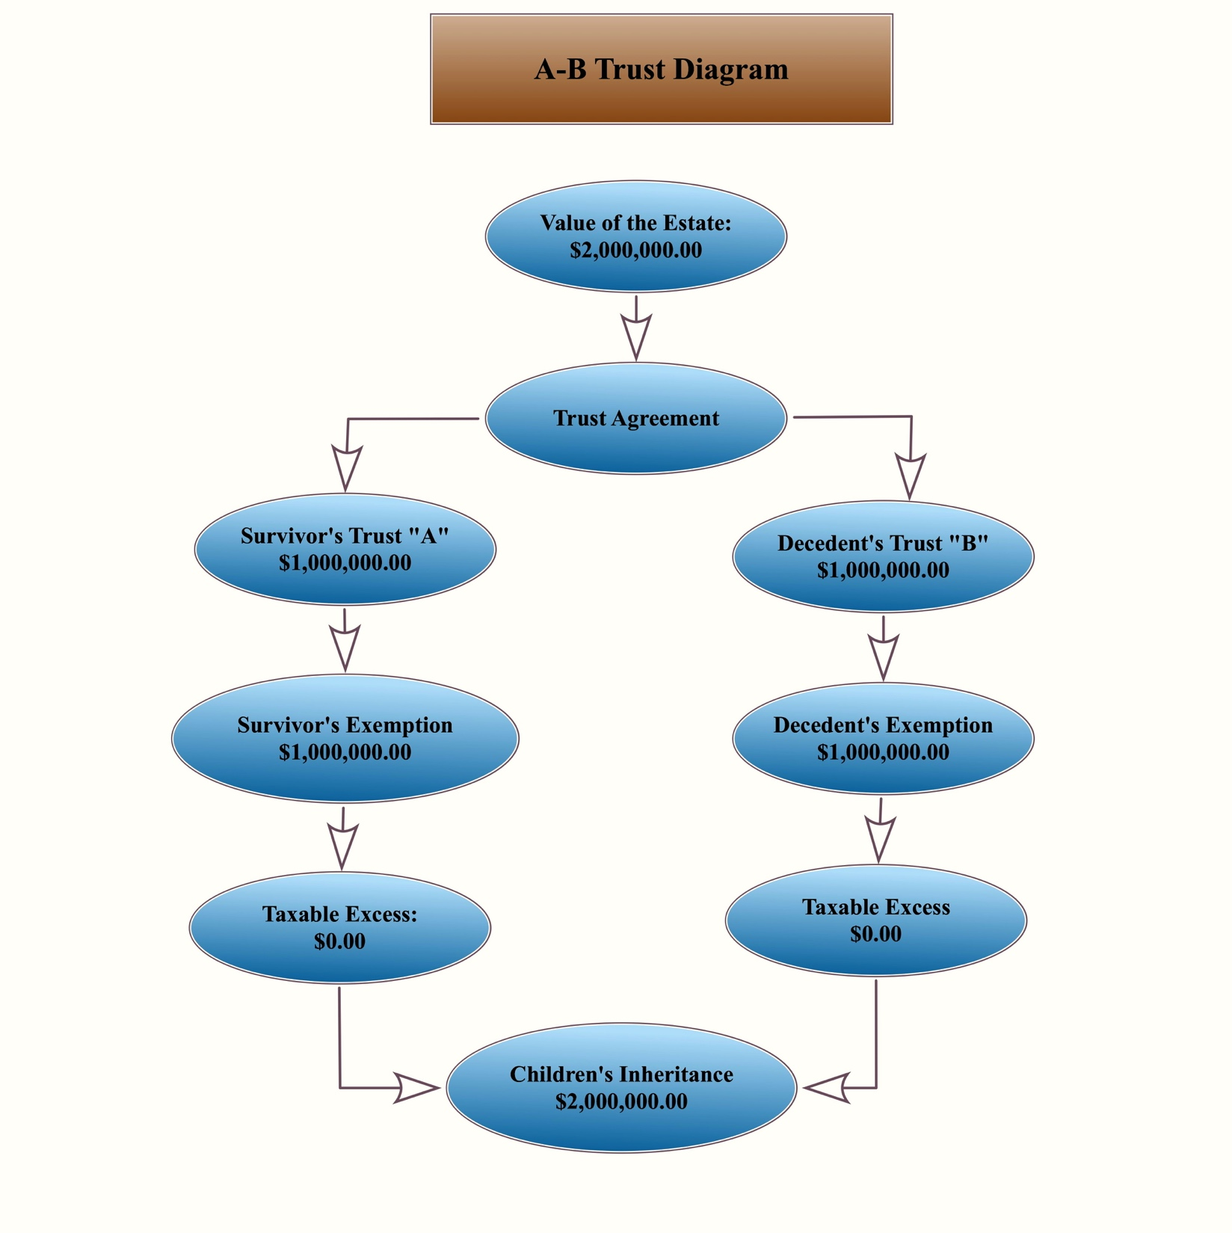
How an AB Trust Works

Slide 44
Current Estate Tax
American Tax Relief Act 2012
- estate tax exemption “permanent”
- $5.43 million, married couples $11.0 million
- Doe this eliminate need for AB Trust?

Slide 45
Wills/Trusts
• Pay the sharks!
• It takes time
• One time only vs. future modifications
• Re-evaluate every few years
• Consider a will during residency but establish trust when you are an attending?
?

Slide 46
College Savings
Jeff Janowicz, MD
Emergency Medicine

Slide 47
Why?

Slide 48
College Savings Plans
• 48% of students do not finish university*
• Ways to provide incentive for parents to save for their children’s future college expenses (the rich become richer!)
• State Education Trusts vs. State 529 plans
*American College Board

Slide 49
How much do you need?
• In past 10 years, tuition is increasing by 4-6%
• Factor in an additional 2% for inflation
• Rate of increase may slow as state governments tie aid to tuition increases

Slide 50
How much do You Need?
Current College Cost 2018*
4-yr public $24,610
4-yr private $49,320
*American College Board

Slide 51
How much do You need?
Estimated cost of college in 2036*
Yearly Inflation 5% 6%
4-Yr Public $51,615 $61,217
4-Yr Private $101,617 $120,522
* American College Board

Slide 52
Michigan Education Trust (MET)
• Prepaid undergraduate tuition program…buy credits now to use later
• Must be used within 15 years of anticipated graduation from high school date
• May be transferred to siblings, cousins, or children
• You can pre-purchase credit hours, semesters, years of college, or entire 4-yr tuition

Slide 53
Michigan Education Trust
• May also be used for in state private school attendance or out of state school attendance but with average or lowest tuition amount refunded to student each year for 4 years
• Lump sum or monthly payments provide tax deduction for contributors
•You can set a payment plan with same cost newborn-adult

Slide 54
Michigan Education Trust
Current Cost (Sept /2018)
Full $71,280
Semester $8,910
Community College $6,640
Credit Hour $594/$111

Slide 55
Michigan Education Savings Plan 529
• Investment fund managed by TIA-CREFF
• Conservative, moderate, and aggressive age-based allocation options
• Also guaranteed options, mutual fund options for investing (not recommended)

Slide 56
529 Investment Options

Slide 57
Michigan 529
• May be used for nearly any higher education expense at nearly any US institution
• Maximum yearly contribution of $25,000, with $10,000 deductible on state income tax
• Transferable to other family members
• Distributions are tax exempt

Slide 58
What to Chose?
All 529
All Michigan Education Trust
MET and some 529?
I chose all 529 – Why?

Slide 59
“10 For 10” Plan
Contribute $10,000 per year for each child for their first 10 years to their 529
10K per year at 5% interest is $195,000 at the age of 18
10K per year at 6% interest is $222,686 at the age of 18

Slide 60
Advice
Wait a year or two to buy a home
You will most likely be married with children…alimony and child support suppress wealth
Use cash when you can
Save for your kids college EARLY
Somebody in the relationship has to be into this stuff
Use spousal income to max out retirement

Slide 61
Advice
Maximize your pretax savings 1st, then tax free growth investments 2nd
401K or 403B, employer contributing plan
54,000/yr at 6% = $4,609,092
401K Traditional
18,500/yr at 6% = $1,550,331
We are here to help
Give it 5-10 years, and you will be amazed at how wealthy you feel

Slide 62
3rd Year Graduation Gift
In 2018, as residents, you will pay 6.2% of your salary ($24,735) in Social Security = $1,534
In 2018, as an attending, you will most likely pay 6.2% on $127,200, the maximum SS tax of $7,886
In 2018, you will have paid MORE THAN the maximum SS tax, you will get this in a REFUND ($1,534) in 2019 when you file your taxes

